Slide 1
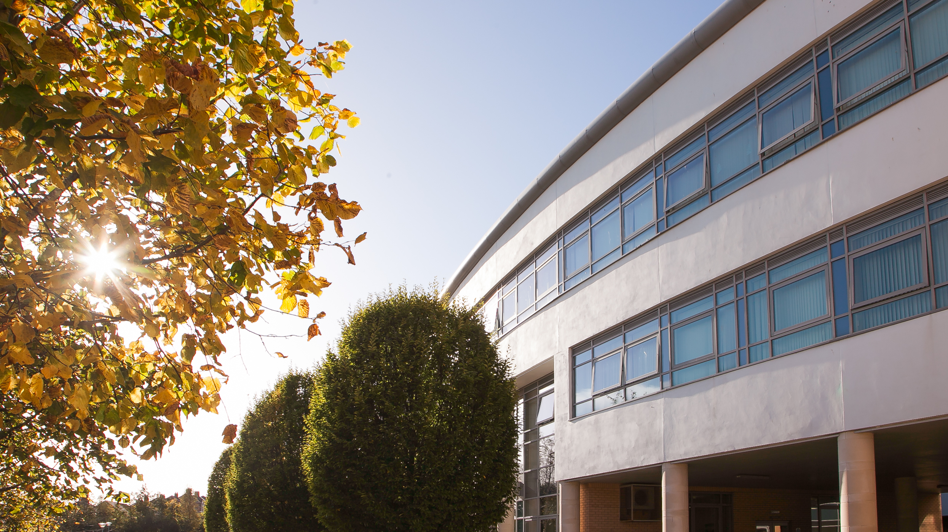
Planning a successful future
Post 16 Options – round 1 open vote
Year 12 Students
March 2025

Slide 2

Nutrition and Food Science
CCEA A Level

Slide 3

Course Content
AS 1 – Principles of Nutrition
AS 2 – Diet, Lifestyle and Health
A2 1 – Option B – Food Safety and Quality
A2 2 – Research Project of Choice

Slide 4



Method of Assessment
AS – two written examinations = 40% of A Level
A2 – written examination (30%) and internally assessed Research Project (30%) = 60% of A Level

Slide 5

Skills Developed
Independence
Interpersonal
Practical
Teamwork
Numeracy
Literacy
Organisational
Presentation
Communication
This Photo by Unknown Author is licensed under CC BY

Slide 6
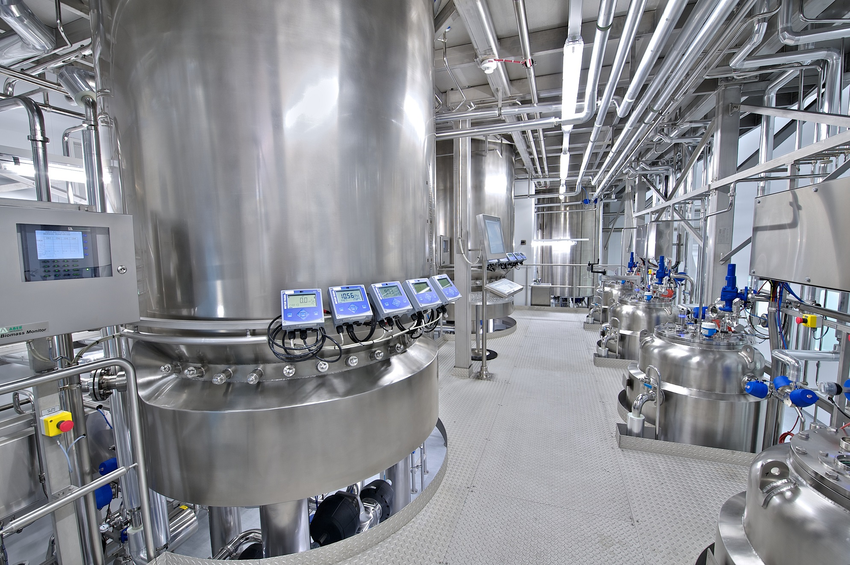
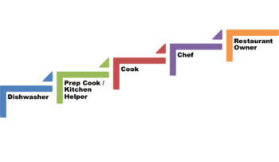
Progression / Career Pathways
This qualification will open up a range of further and higher level courses for you to choose from.
Some Career paths are shown here –
Food Technologist Food Processor
Product Developer Tourist Industry
Dietician Leisure Industry
Nutritionist Hotel Management
Restaurant Management Chef

Slide 7

Sociology
A-Level

Slide 8
Course content
A-level Modules
Compulsory content
4.1 Education with Theory and Methods
Crime and Deviance with Theory and Methods
Crime and Deviance
Theory and Methods
Optional Units
4.2 Topics in Sociology
Culture and Identity
Families and Households
Health
Work, Poverty and Welfare
Beliefs in Society
Global Development
The Media
Stratification and Differentiation
Sociology is the study of society - how people interact in groups. A level Sociology examines social behaviour from a variety of perspectives: how it originates and then develops, and the ways people are organised into groups according to distinctions such as class, gender and race.
AS Modules
Compulsory content
Education
Methods in Context
Research Methods
Optional Units
3.2.2 Topics in Sociology
Culture and Identity
Families and Households
Health
Work, Poverty and Welfare

Slide 9
How is it assessed?
AS [YEAR 1]
2 external exams
A2 [Year 2]
3 external exams
100% Exam based

Slide 10
Skills developed
Critical Analysis
Independent Thinking
Research
Problem Solving
Teamwork
Presentation
ICT
Literacy + Numeracy

Slide 11

Progression routes/Careers pathways
Social worker - Sociologist
Human Resources - Solicitor
Community development worker - Youth Worker
Marketing - Administrative Officer
Police officer - Charity officer
Civil Service administrator - Policy Officer
Counsellor - Teacher
Public Relations Officer - Advice worker
Further education teacher - Business Analyst
Journalist - Probation Officer
Market research

Slide 12
Why choose THIS A-LEVEL?
Universities recognise that sociology A Level provides students with a very good foundation in social, political and policy knowledge.
Sociology is regarded as a demanding and rigorous A Level which combines well with any other combination of subjects.
It encourages a critical understanding of contemporary society.
Sociology equips you with a core knowledge of society, how it works and how it changes.
No coursework.

Slide 13

A Level
Environmental Technology
CCEA
Course Breakdown
2 Exams
2 Portfolios
50% Exam
50% Coursework
Subject is a combination of Double Award Science, Maths, Geography and Technology

Slide 14
Year 13
AS Component 1: The Earth’s Capacity to Support Human Activity
1hr 30min exam
(20% of overall A Level)
AS Component 2: Renewable Energy Technologies
Controlled Assessment
Produce a technical report based on a realistic scenario relating to the use of renewable energy technologies
(20% of overall A Level)

Slide 15
Year 14
A2 Component 1: Building and Managing a Sustainable Future
2hr exam (30% of overall A Level)
A2 Component 2: Environmental Building Performance and Measurement
Controlled Assessment
Produce a technical report relating to the environmental performance of a local building.
(30% of overall A Level)

Slide 16
Reasons to Study an Environmental Technology Course?
Study Interesting Topics
Develop New Skills
Tackle Challenges/Problem Solving
Wide Range of Career Paths
Be In Demand
Travel The World

Slide 17

Skills Developed
Communication
Self-evaluation and self-management
Presentation
Evaluation
Creativity
Working with others
Decision making
Planning
Problem Solving
Literacy – Research, analysis and evaluation
Numeracy Skills – Data analysis

Slide 18

Associated Careers
Manufacturing
Electricity, Gas & Water Management
Construction
Wholesale and Retail Trade
Environmental Consultancies
Waste Management
Environmental Technician
Project Management
Landscape Architect
Construction Engineer
Engineering Technician
Chartered Engineer
Urban Planner
Ecologist
Renewable Energy and Sustainability Co-Ordinator

Slide 19
BTEC Level 3
Engineering
Pearson
Course Breakdown
2 Exams 2 Portfolios
66% Exam 33% Coursework
*Contains large quantity of Maths Calculations/Equations*
**High performance in Maths Recommended**

Slide 20
Year 13
Year 14
Unit 1: Engineering Principles
Written Exam
2hr exam (33% of overall BTEC)
Unit 2: Delivery of Engineering Processes Safely as a Team
Controlled Assessment (Non Exam)
(16.5 % of overall BTEC)
Unit 3: Engineering Product Design and Manufacture
Written Supervised Assessment
8hr total (33% of overall BTEC)
Centre chosen Unit
Unit 44: Fabrication Manufacturing Processes
Controlled Assessment (Non Exam)
(16.5% of overall BTEC)

Slide 21
Reasons to Study an Engineering Course?
Study Interesting Topics
Develop New Skills
Tackle Challenges/Problem Solving
Wide Range of Career Paths
Be In Demand
Travel The World
Skills Developed
Communication
Self-evaluation and self-management
Presentation
Evaluation
Creativity
Working with others
Decision making
Planning
Problem Solving
Literacy – Research, analysis and evaluation
Numeracy Skills – Data analysis
Associated Careers
Manufacturing
Construction
Architecture
Landscape Architect
Construction Engineer
Mechanical Engineer
Civil Engineer
Systems Engineer
Quantity Surveyor
Engineering Technician
Chartered Engineer
Urban Planner

Slide 22
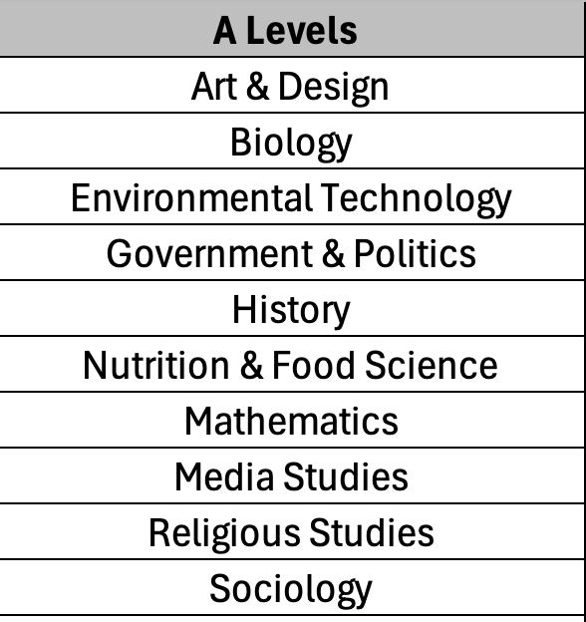
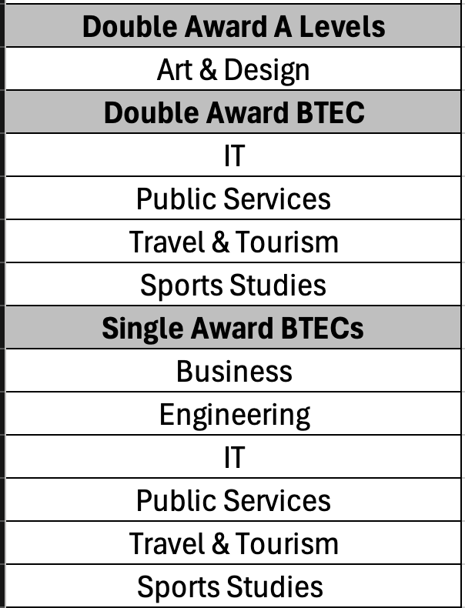

Level 3 subjects on offer – 2yr course

Slide 23
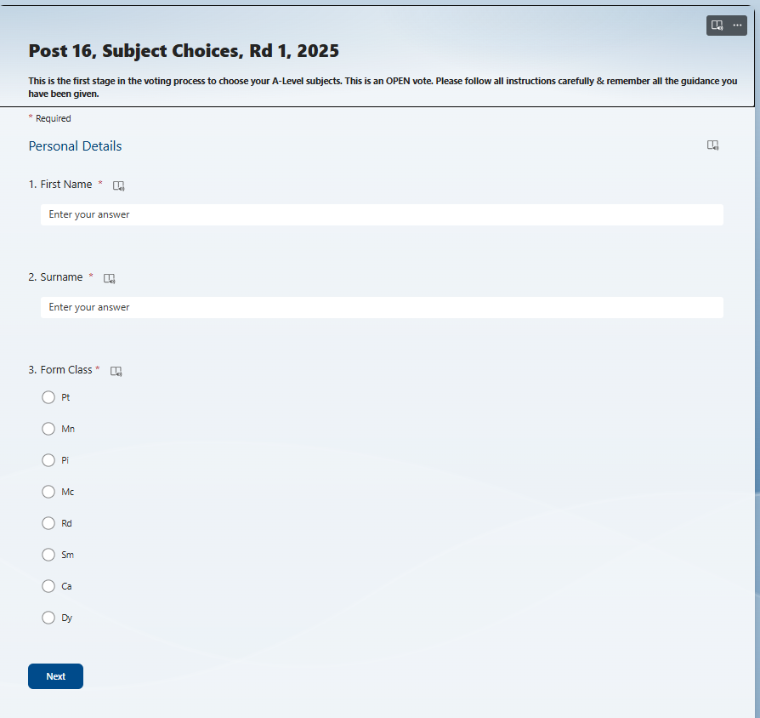
Step 1 - Link
Completion of Choices – MS Forms
Your parents will be sent a link for each round (via text & Parent App) like this:
https://forms.office.com/e/FgeKn5k6YA
PUT into a web browser and it will take you to this page
You will also be able to access this from your Year 12 Team
Complete these details and click Next to take you to the guidance
Vote opens on - Monday 3rd March
Deadline for voting – Wednesday 5th March

Slide 24

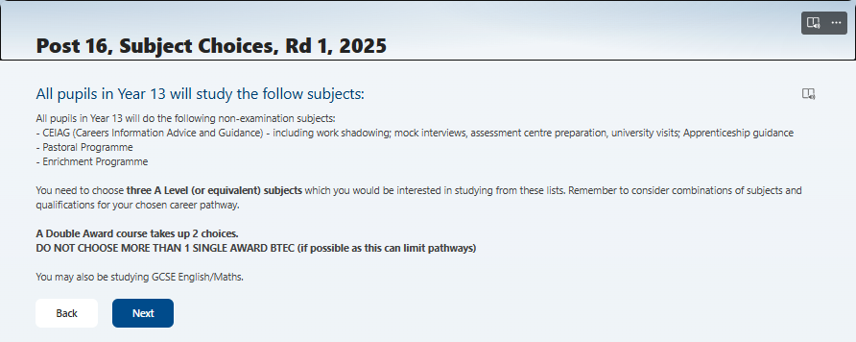
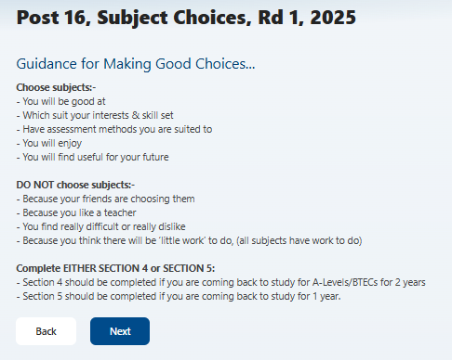
Step 2 – Guidance
Read this guidance information section carefully before making your choices
If you click on this icon, it makes the text bigger & it will read the information aloud

Slide 25
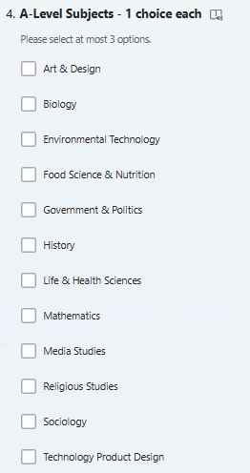

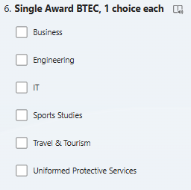
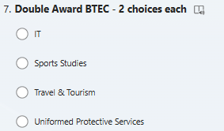
Step 3 - 2-year option
Choose the subjects you want to study Post 16​
Remember you are only allowed 3 choices​
It can be a combination of A-Levels & BTEC subjects​
Those in the RED box take up two choices

Slide 26
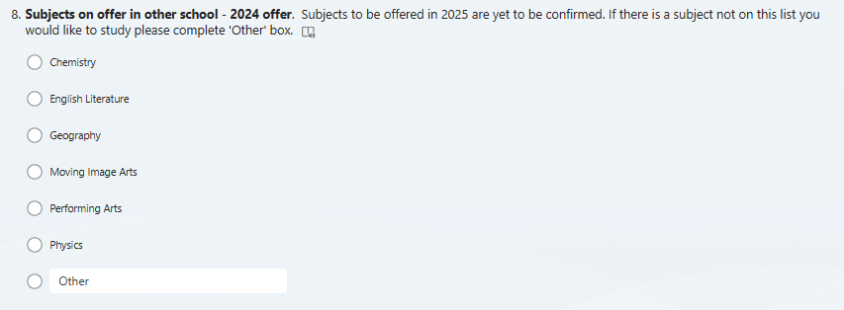
Step 4 – ALC subjects
Some subjects not available in BBMS can be studied in other schools​
This is the 2024 offer, 2025 offer to be confirmed​
ONLY choose a subject here if it is not offered at BBMS​
If there is another subject you would like to study, but it is not an option, please put in 'Other"

Slide 27
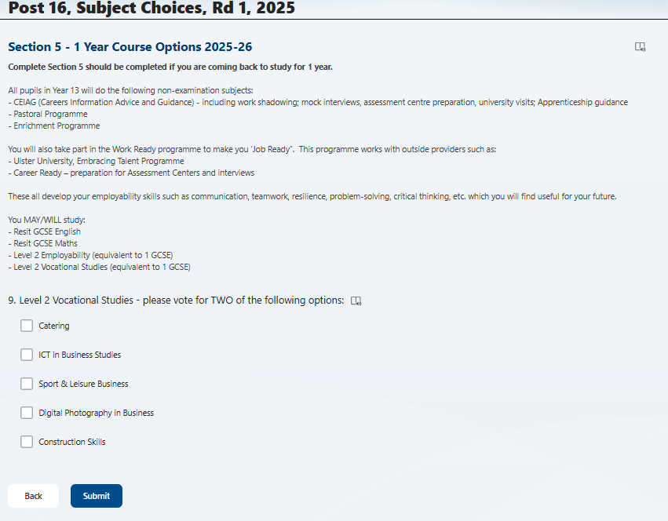

Step 5
1year option ​
Choose this option if you are coming back for 1-year​
If you have not achieved a grade C in your English OR Maths you will
resit these subjects ​
Finally, click submit when you have made your choices

Slide 28
Questions?
If you have any queries, please contact:​
Mrs. Deehan - SLT Progression ​- kdeehan546@c2ken.net
Mrs.Ryan - Head of Careers​ - nryan320@c2ken.net

