Slide 1
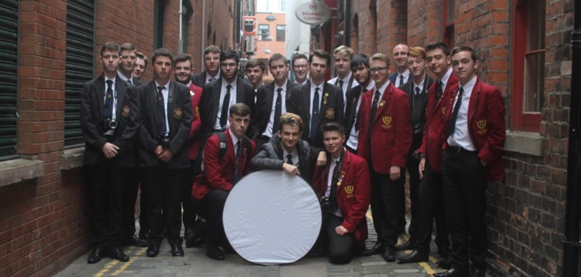
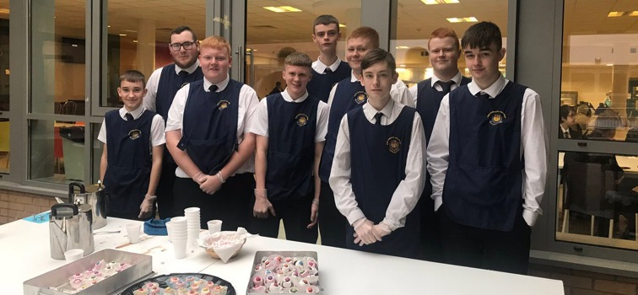
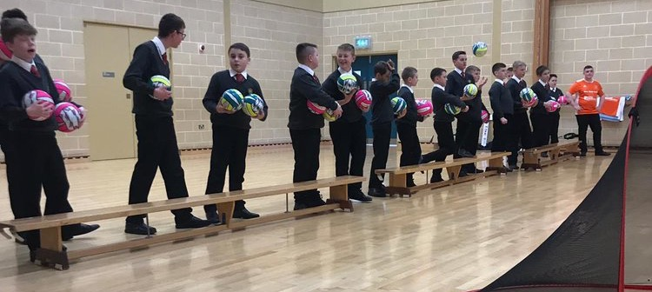
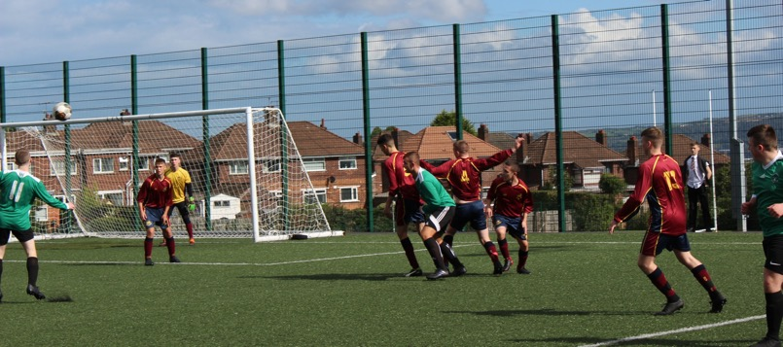
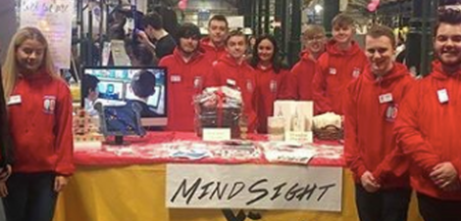
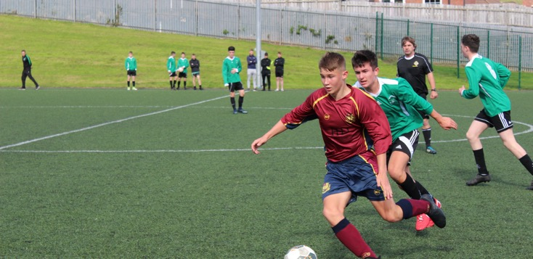
ENRICHMENT CHOICES
2020
BBMS

Slide 2
MODEL EXTRA
In BBMS, we are not only trying to get you exam results, we are trying to develop your whole person.
That includes your employability in the world of work, how you cope with the challenges of life and how to communicate effectively with others.

Slide 3
Through BBMS Enrichment you have been given the opportunity to develop a range of skills that include: ​
Leadership
Teamwork
Resilience
Communication
Literacy, Numeracy and Technical Skills
Problem Solving
Creative and Critical Thinking
Independence

Slide 4
Enrichment Options for 2020

Slide 5
ENRICHMENT OPTIONS INCLUDE....
BOXING
HEALTH AND FITNESS
IFA SPORTS COACHING
MENTORING
INDOOR SPORTS
TAMHI
STREETBEAT
UPCYCLING
YOUTH WORK IN COMMUNITIES
ANY MANY MORE........

Slide 6
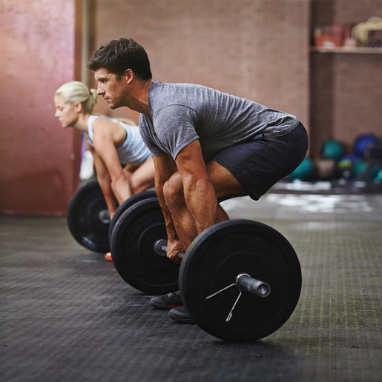
Health and Fitness: Why Fitness
This course helps you develop a range of SKILLS including:​
​Leadership and team work​
Organisation​
Empathy​
Communication​
Self-discipline ​
Professionalism​
Creativity​
Motivation

Slide 7
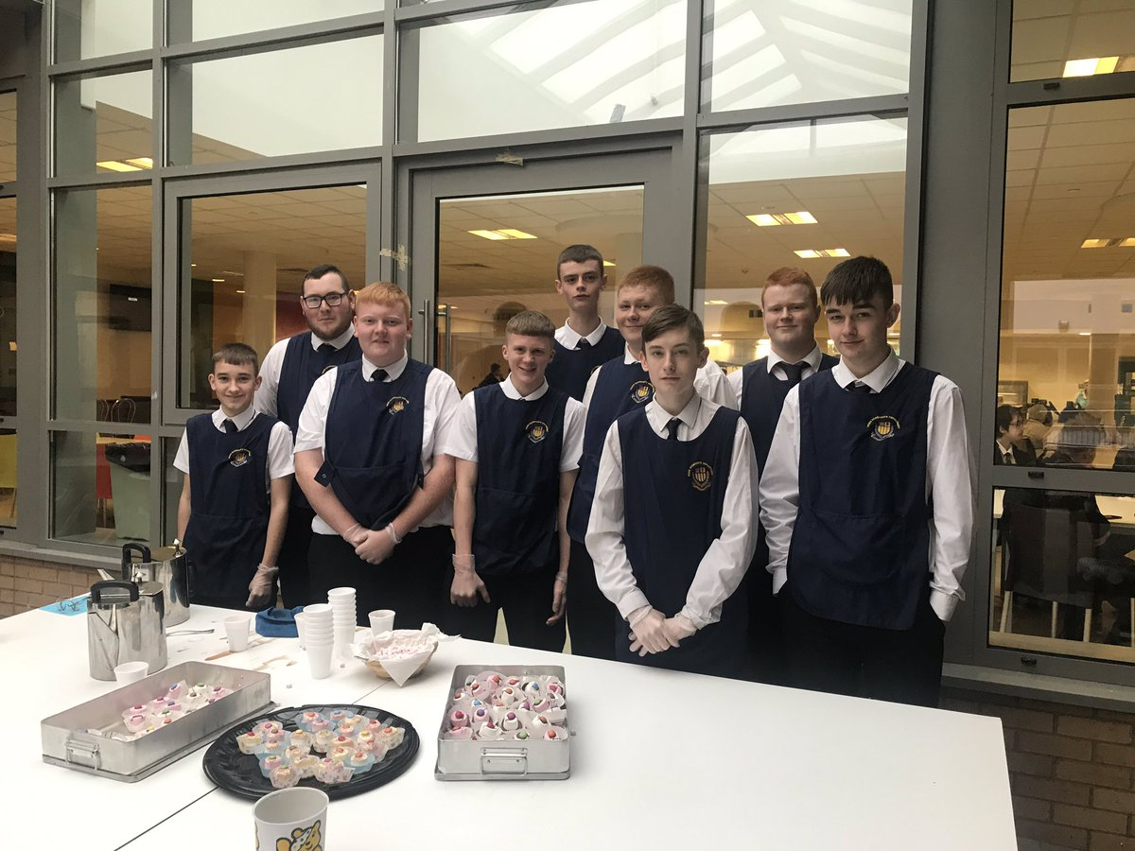
Hospitality
Learn and/or improve your practical catering skills by planning and preparing a variety of dishes.
Develop leadership, teamworking and customer service skills by taking part in a number of charity events.
Opportunity to obtain a Level 2 Award in Food Safety and Hygiene from the Royal Society of Public Health – this can be used to help gain employment in the Hospitality Sector.

Slide 8
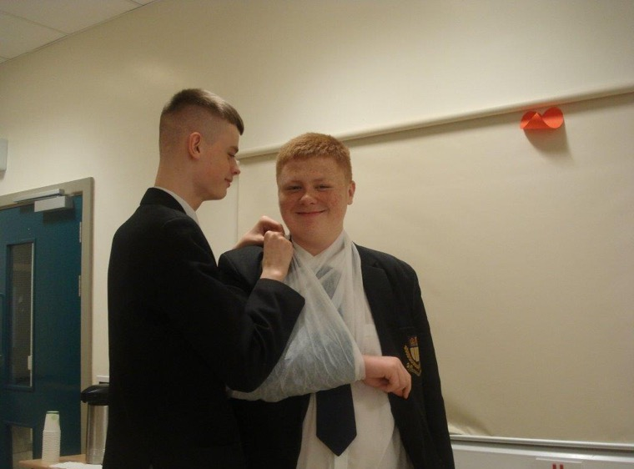
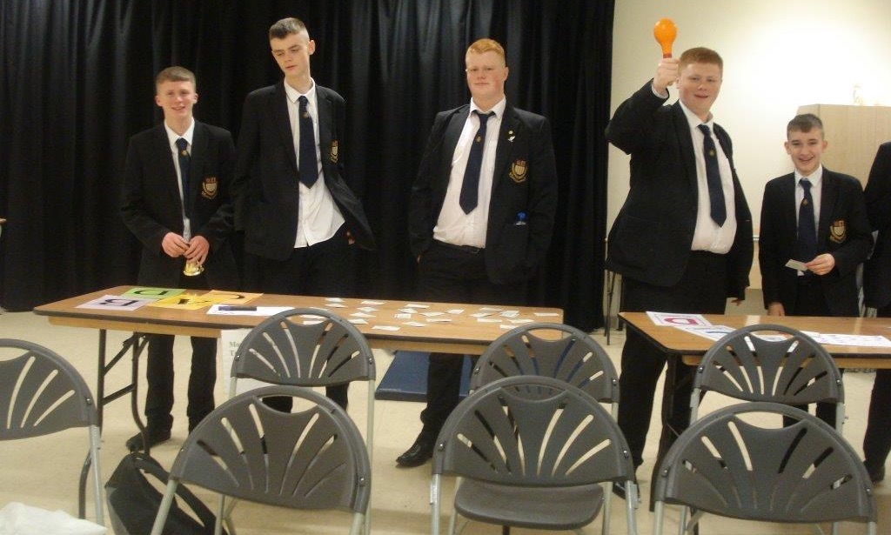
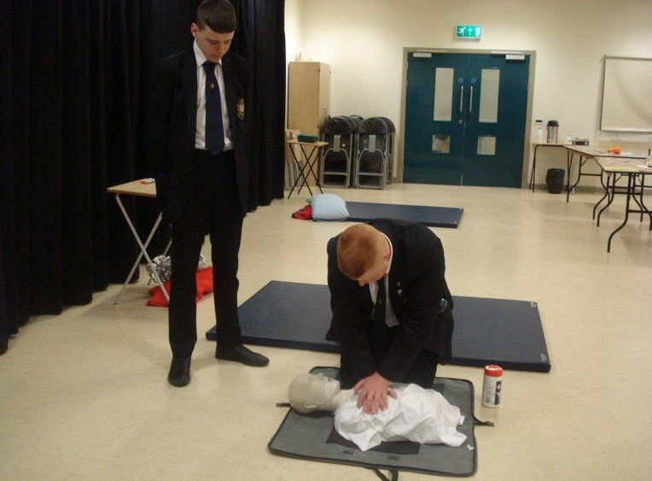
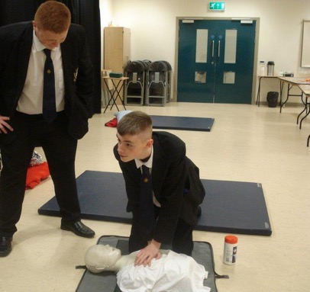
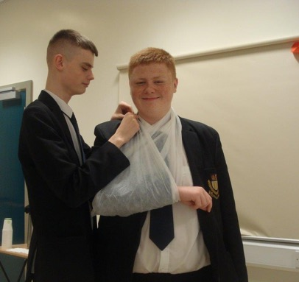
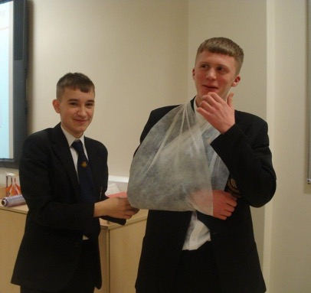

Slide 9
Year 12-14 Games Options
All pupils expected to have a school Kit for this (old version or new)

Slide 10
Boxing
Focus on Boxing styled circuit training
Develop boxing movements, coordination and fitness
Pad work
Striking
Requires commitment, dedication and toughness
Taken by a Boxing coach and Mr Gray

Slide 11
Duke of Edinburgh Award
Opportunity to gain a Silver Duke of Edinburgh Award
Practical sessions in preparation for a 3 day (2 night) expedition in the Mournes
Focus on teamwork, map reading and campcraft
Will improve communication, organisation, leadership and many other essential skills.
An Award that is highly acclaimed by universities and employers alike

Slide 12
Competitive Football: IFA
U16A and B and U18A and B teams
Cup competitions
Friendly matches
Specialist training
Requires commitment and dedication to the team, as well as developing fitness, communication, leadership and teamwork skills
Led by Mr Mills, Mr Murray, Mr O’Loan and Mr B McLaughlin

Slide 13
Sports Coaching Enrichment
BCSDN Programme
IFA Programme
Various coaching/leadership award, including………
Disability sport NI
Sport Leaders L1
Dodgeball coaching award
Heart start
Coaching event with Primary Schools
Working with other local schools
Workshops and programmes through the Irish Football Association, including…
Futsal coaching award
Volunteering workshop
Introduction to coaching award
Introduction to Refereeing
Inclusion workshop

Slide 14
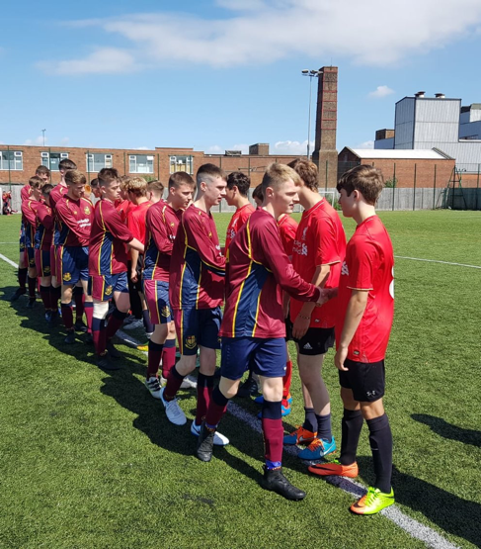
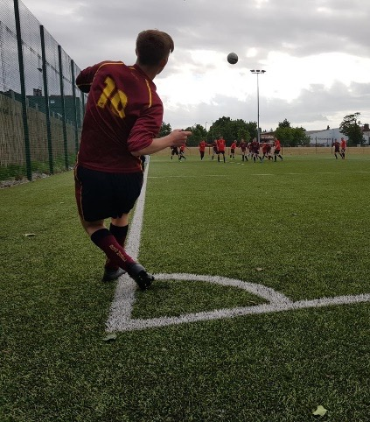
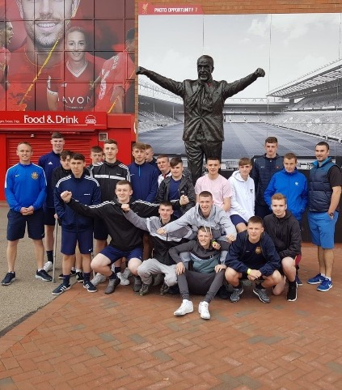
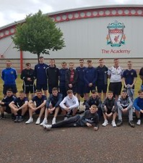
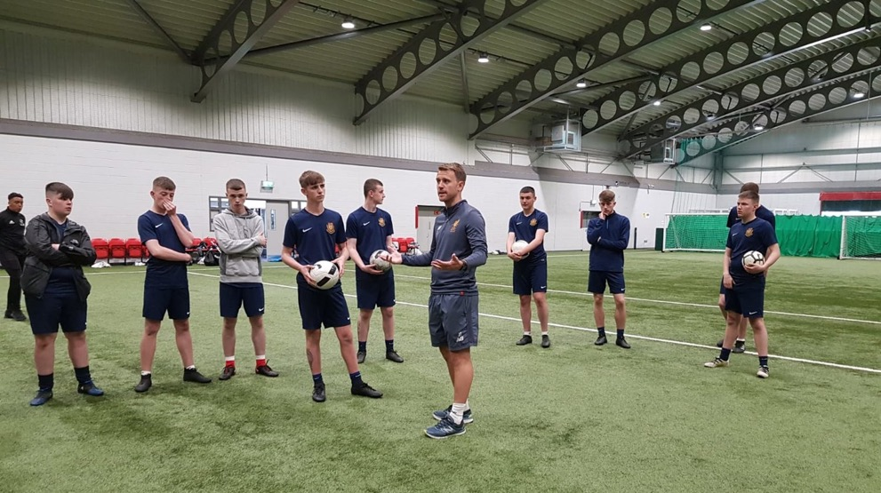
Sports Coaching
Leadership skills and knowledge in range of sports will be developed
Represent the school in local community and schools
Various leadership/coaching qualifications, delivered by governing bodies
Develop leadership, organisational, communication, lifeskills (e.g. First Aid)
Sports Educational trip

Slide 15
Indoor Sports
General Indoor Sports allow you to access sports that interest you. You will take ownership of the activities and create tournaments, set the rules, referee/umpire and record results you must regularly bring your kit to PE to chose this options and have been an active participant from Y8-11 in both PE and Games.

Slide 16
Mu
MUSIC PERFORMANCE

Slide 17
DJ-ING

Slide 18
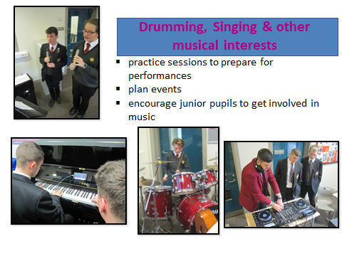

Slide 19
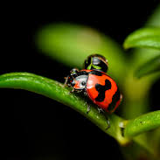
Photography

Slide 20
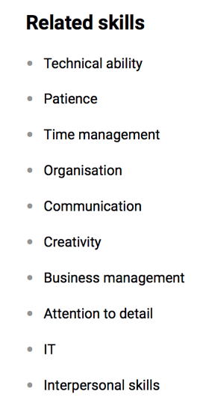
Photography Enrichment Information Hobby/Career/Volunteer
Use of Professional
Equipment
Workshops
Gallery Visits
Compliments/Enhances
your studies
You can see some examples of photographs on the next
slide

Slide 21
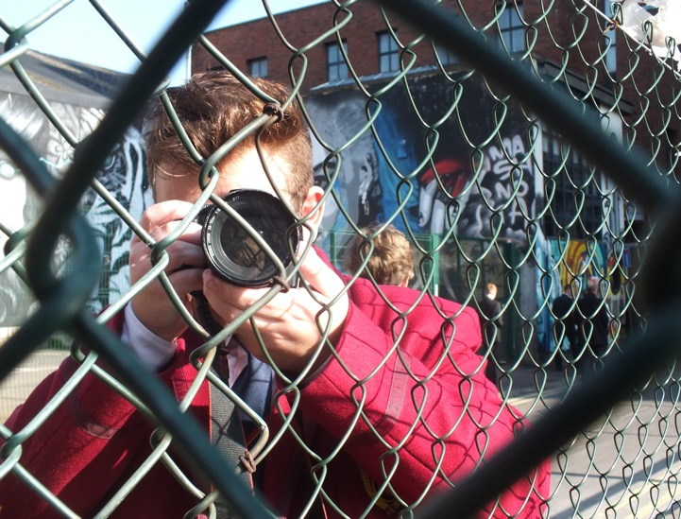
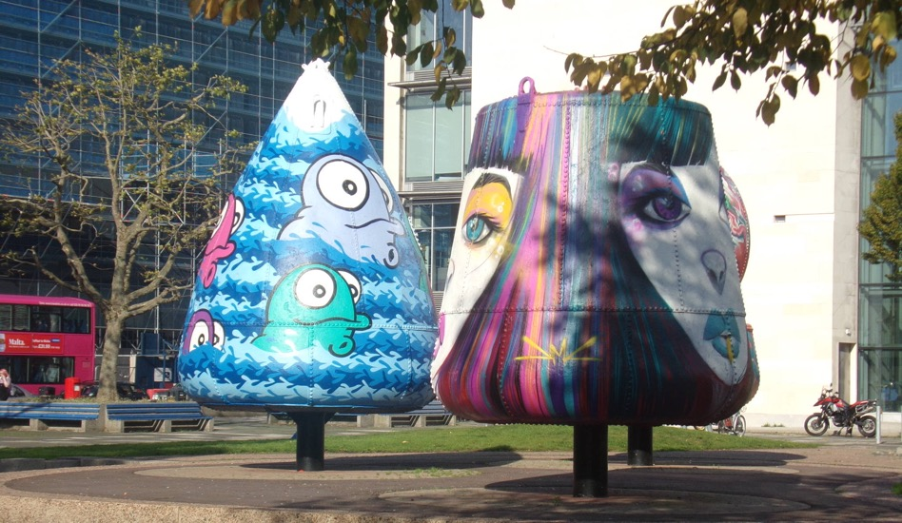
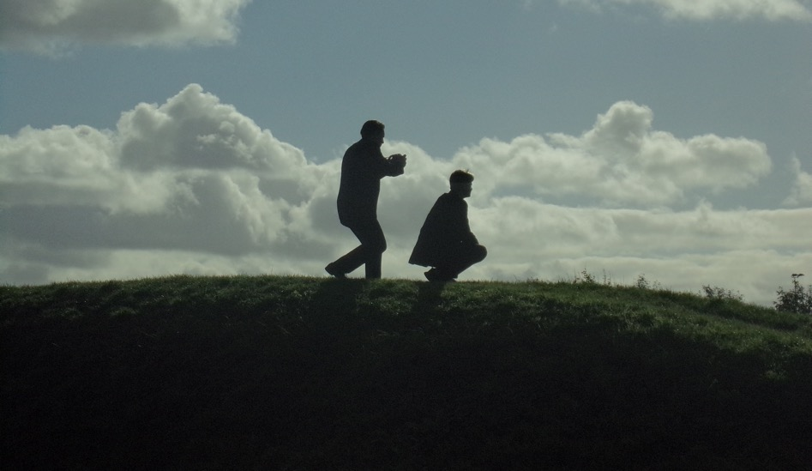
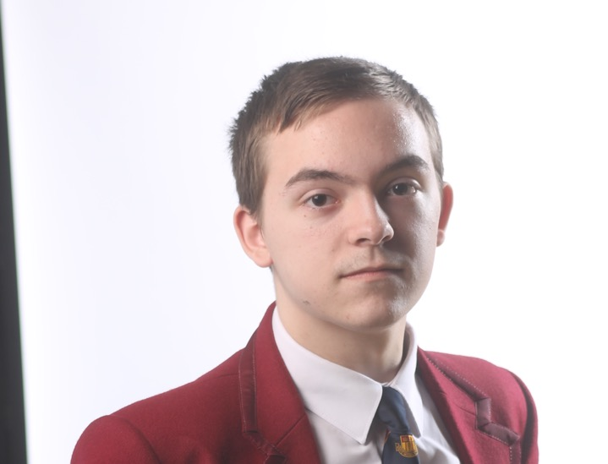

Slide 22
The Voice
The Voice is an enrichment that is aimed at improving our communication skills.
It will give you the opportunity to see how communication in the real world takes place - everywhere from the council chambers to the radio studio.
You will get the opportunity to hear people tell you about their journey and how their oracy skills helped them.
You will be able to debate relevant topics with your peers and you will hear how to get your point across without having to shout the loudest.

Slide 23
Young Enterprise Company Programme
Gain experience in setting up and running your own profit-making business.
You make all the decisions about your business from
Deciding on the name of the company
The product you are going to sell
Managing the company finances
Selling your product to the public at trade fairs.

Slide 24
Opportunities
Supported by a volunteer business adviser who brings a wealth of business knowledge and industry related expertise.
At the end of the year, you will have the opportunity to enter into a competition against all schools in Northern Ireland for the ‘Company of the Year Award’.
Winning team will go on to compete in London at the UK regional's.
Run from September – April. Therefore, you will only be able to participate in this enrichment programme for the year instead of having the two options.

Slide 25
Lighthouse Mentoring
Endeavour programme- Gain an OCN in peer mentoring to work with struggling Y8 students to help them settle.
Only open to Year 12 students going into Y13 in 2020.

Slide 26
Youth Work In Communities
A youth worker will deliver a tailored programme to enable you to access an OCN qualification. They will complete various workshops and activities throughout.

Slide 27
TAMHI
Several youth workers will deliver a tailored programme of mental health awareness training while giving you the skills to deliver workshops on helping young people cope with the stresses of everyday life. This requires you to be very committed but is an excellent opportunity to gain a wide range of transferable skills. The programme also involves a few trips as well as a celebration event. It lasts all year.

Slide 28
Streetbeat will enable you to gain qualifications through fun and interactive training. They will support the programme with visits and trips to ensure you develop the necessary skills needed work the world of work. It requires you be to committed and potentially attend outside school hours.

Slide 29
Volunteering
If you have a particular interest in a charitable cause, we can arrange a volunteering placement within Belfast
You will go to this on a Wednesday afternoon and provide support, friendship and help you the charity.
This option requires commitment- you need to be able to attend every week, no excuses
They are counting on you!

Slide 30
Casting and Sculpture Design: Flax Trust
Working with the flax trust through the manufacturing process of making sculptures using the casting process.

Slide 31
Upcycling
Working with the Women’s Tech, students will gain practical skills in tiling and upcycling goods in a supportive environment.
This is a shared enrichment with Mercy College

Slide 32
ENRICHMENT IN BBMS

